Slide 1

Brittany Lakes Homeowners' Association, Inc.
Reconvened Annual Meeting 2022
December 15, 2022

Slide 2


Annual Meeting Agenda
Call to Order: 6:30 PM
  Proof of Notice
  Determination of Quorum
  Introductions
    Board
    Management
Approval of 2021 Annual Minutes
Financial Report
2022 Overview
Announce the Election of Board Members
Questions & Answers Session
Adjournment

Slide 3
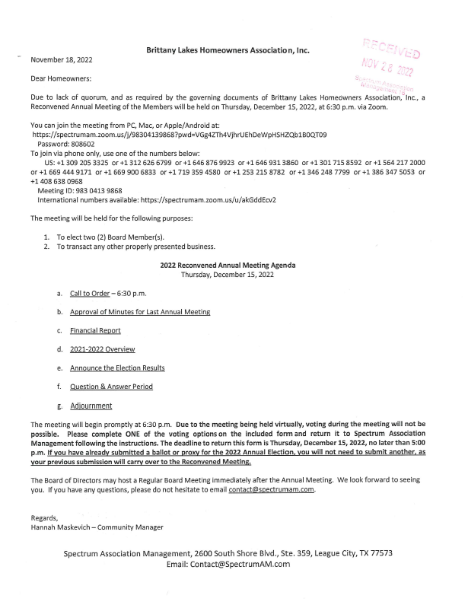
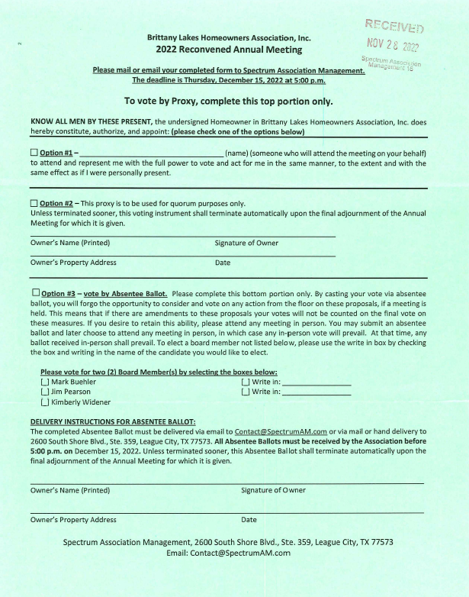
Proof of Notice

Slide 4
Determination of Quorum
Quorum needed: 32 members – 2.5% of members
64 ballots received – Quorum has been met

Slide 5
Introductions
Board of Directors
President: Todd Edwards
Vice President: James Charo
Treasurer: Kimberly Widener
Director: Jeramy Roesler
Director: Diana Lawless
Spectrum Association Management
Hannah Maskevich
832.500.2301
contact@spectrumam.com

Slide 6
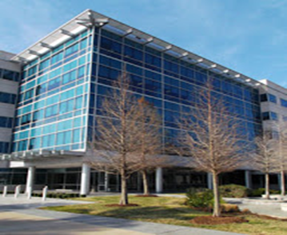
Spectrum Office
2600 South Shore Blvd Suite 359, League City, TX 77573
Community Manager- Hannah Maskevich
Client Relations Manager– Tiffany Sanford
https://www.spectrumam.com
  Payment Center – Make payments via credit card, e-check or automatic ACH withdrawal directly from Spectrum’s website.
  Account Overview – View all charges and payments posted to an account for the past year. Plus, owners can update mailing addresses, phone numbers and e-mail addresses.
  Compliance Center – View a comprehensive list of all compliance letters sent for the past year.
  Improvement Center – Submit ACC/ARC improvement requests online and upload all required documents.
  Message Center/Live Chat – Ask questions, report violations, request items (such as a pool key card, gate remote, etc.). Responses are sent by a Spectrum representative and posted to the homeowners' account.

Slide 7
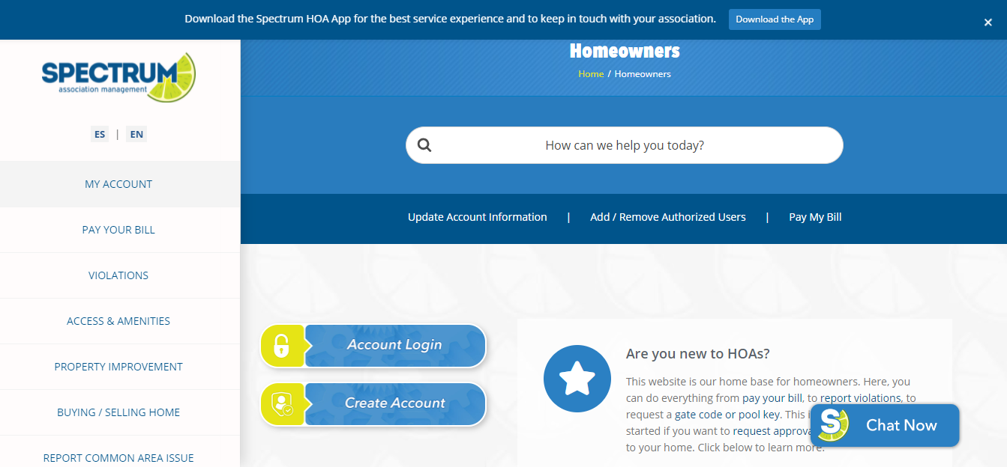
www.spectrumam.com
Review governing documents/policies
View community information
  Homeowner/resident directory
  View community map
  View meeting minutes
  View notices/newsletters
  Development/construction information
Pay your assessments online
View your account/violation history
Print/fill out forms (ACC)
Use online chat feature

Slide 8


Slide 9
2021 Annual Meeting Minutes Approval
Brittany Lakes Homeowner Association, Inc.
Annual Meeting of the Members Minutes
October 28, 2021
Pursuant to the Bylaws of the Brittany Lakes Homeowners Association, Inc. an Annual Meeting of the Members was duly called and held on October 28, 2021, via Zoom meeting. The meeting was called to order at 6:36 p.m.
IN ATTENDANCE
Representing the Members of Brittany Lakes Homeowners Association were the following Board members:
• Todd Edwards (President)
• James Charo (Vice-President)
• Diana Lawless (Member at Large)
• Jeramy Roesler (Secretary)
• Kimberly Widener (Treasurer)
Representing Spectrum Association Management, LP was:
Community Manager - Hannah Maskevich
Client Relations Manager – Tiffany Sanford
DETERMINATION OF QUORUM
Representing the Members of the community were 39 homeowners present in person and via proxy. The Governing Documents state that quorum is met at 10% of the membership (128 members). At this time, quorum has not been met.
ADJOURNMENT
Due to quorum not met, the meeting was adjourned at 6:37 p.m.
NEXT MEETING DATE
The reconvened Annual Meeting is scheduled for 11.18.2021.

Slide 10
2021 Reconvened Annual Meeting Minutes Approval
Brittany Lakes Homeowners Association, Inc.
Reconvened Annual Meeting Minutes
November 18, 2021
Pursuant to the Bylaws of the Brittany Lakes Homeowners Association, Inc. an annual meeting of the membership was duly re-called and re-convened on November 18, 2021, via Zoom.
IN ATTENDANCE
Representing the Members of Brittany Lakes Homeowners Association, Inc. were the following Board Members:
• Todd Edwards – President
• James Charo – Vice President
• Jeramy Roesler – Director at Large
Absent with apologies were the following Board Members:
• Kimberly Widener – Treasurer
• Diana Lawless – Director at Large
Representing Spectrum Association Management were the following:
• Hannah Maskevich – Community Manager
• Tiffany Sanford – Client Relations Manager
DETERMINATION OF QUORUM
Representing the Members of Brittany Lakes were 65 members present in person and via proxy. A quorum of homeowners was announced by Community Manager Hannah Maskevich and the meeting was called to order at 6:31 pm.
PROOF OF NOTICE
The membership was presented with a copy of a meeting notice which was mailed out to the membership announcing the meeting.

Slide 11
2021 Reconvened Annual Meeting Minutes Approval
INTRODUCTIONS
The membership present was introduced to the current sitting Board of Directors and the representatives for Spectrum Association Management.
2020 ANNUAL MEETING MINUTE APPROVAL
The Board and membership were provided a copy of the 2020 annual meeting minutes for review and approved.
Motion – Todd; second – James, all in favor, no oppositions
FINANCIALS
The financial report was provided to the membership showing the financial overview of 2020, as well as the year-to-date financial overview of 2021.
Year-end 2020: Year-to-date 2021:
Operating account(s): $307,306.98 Operating account(s): $232,048.45
Reserve account(s): $403,688.74 Reserve account(s): $502,750.83
The fiscal year for 2020 ended $58,376.01 under budget. 2021 is projected to end approximately $59,705.84 under budget.
2020 OVERVIEW
The following projects were completed during 2020-2021:
• Roof replacement at the front structure and at the pool house
• New wind nets installed at the tennis courts
• Pool house painting update completed
• Landscaping clean-up from the Winter Freeze in 2021
• Pool shower and picnic table replacements approved; pending delivery and installation

Slide 12
2021 Reconvened Annual Meeting Minutes Approval
The following projects are anticipated to occur during 2022:
• Continuing landscaping clean-up, to include tree trimming
• Repairs to the transfer pump that connects to the irrigation system
• Replace the canopies at the park near Loon and Longspur
• Camera systems updates throughout the community
• Addressing drainage concerns at the Recreation Center
• Pool area updates (replaster the pool surface, painting/updating the splash pad area)
ELECTION OF BOARD MEMBERS
Spectrum announced the Board Election session and noted there were three open seats and three candidate submissions that had been received. Spectrum announced that the winners of the election were Todd Edwards, James Charo and Jeramy Roesler.
QUESTION & ANSWER SESSION
The floor was opened for the question and answer session. Owners present were provided the opportunity to discuss various items related to the Association including:
• Homeowners inquired about the construction project that is moving along West League City Parkway. It was requested to have the Project Manager for League City invited to the next Board Meeting to discuss the project with homeowners.
• The homeowners asked about the flag displays and which holidays were included.
• Homeowners inquired about the assessment increase and the approved budget for 2022.
ADJOURNMENT
With all business discussed and no other or new business presented to be discussed, the meeting was adjourned at 7:17 P.M.

Slide 13
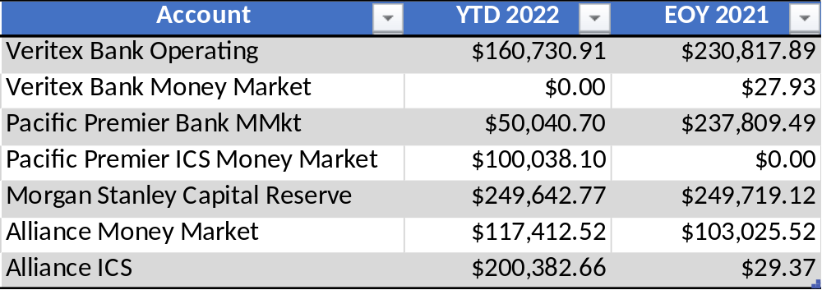
Brittany Lakes
Bank Balances: Year-End 2021 and YTD 11/30/2022
$55,121.19
$25,553.62
Notes:
UPDATE WHEN INFORMATION IS AVAILABLE

Slide 14
SLIDE TITLE

Slide 15
2021 Year-End Expenses
Notes:
UPDATE WHEN INFORMATION IS AVAILABLE

Slide 16
SLIDE TITLE
Notes:
UPDATE WHEN INFORMATION IS AVAILABLE

Slide 17

2022 YTD Expenses

Slide 18
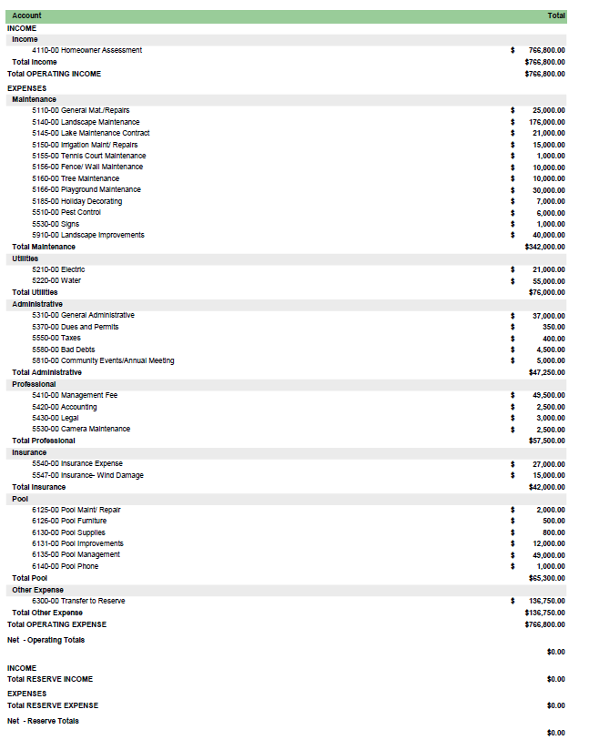
Approved 2023 Budget
Assessments = $600.00 per lot

Slide 19
2021-2022 Overview
Shower replaced at the pool
Pool replaster mostly completed; vendor will return for warranty work in the Fall
Canopy replaced at Longspur Park
Tree trimming at the Rec Center
Mailboxes pressure-washed and repainted throughout neighborhood
Security cameras replaced throughout the neighborhood
Sidewalk repairs and pavers replaced at Longspur Park
Benches replaced at the Rec Center
Free Little Library installed at the Rec Center – Emma Downs (Brittany Lakes resident Community Project)

Slide 20
2021-2022 Overview
Grill replaced at Rec Center and brick repairs
Picnic tables replaced at the pavilion
Splash pad repainted (surface and features)
Parking lot pressure washed and restriped
Tennis court resurfaced
New pool rules and tennis court rules filed with the County
Landscaping replaced at the pool area

Slide 21
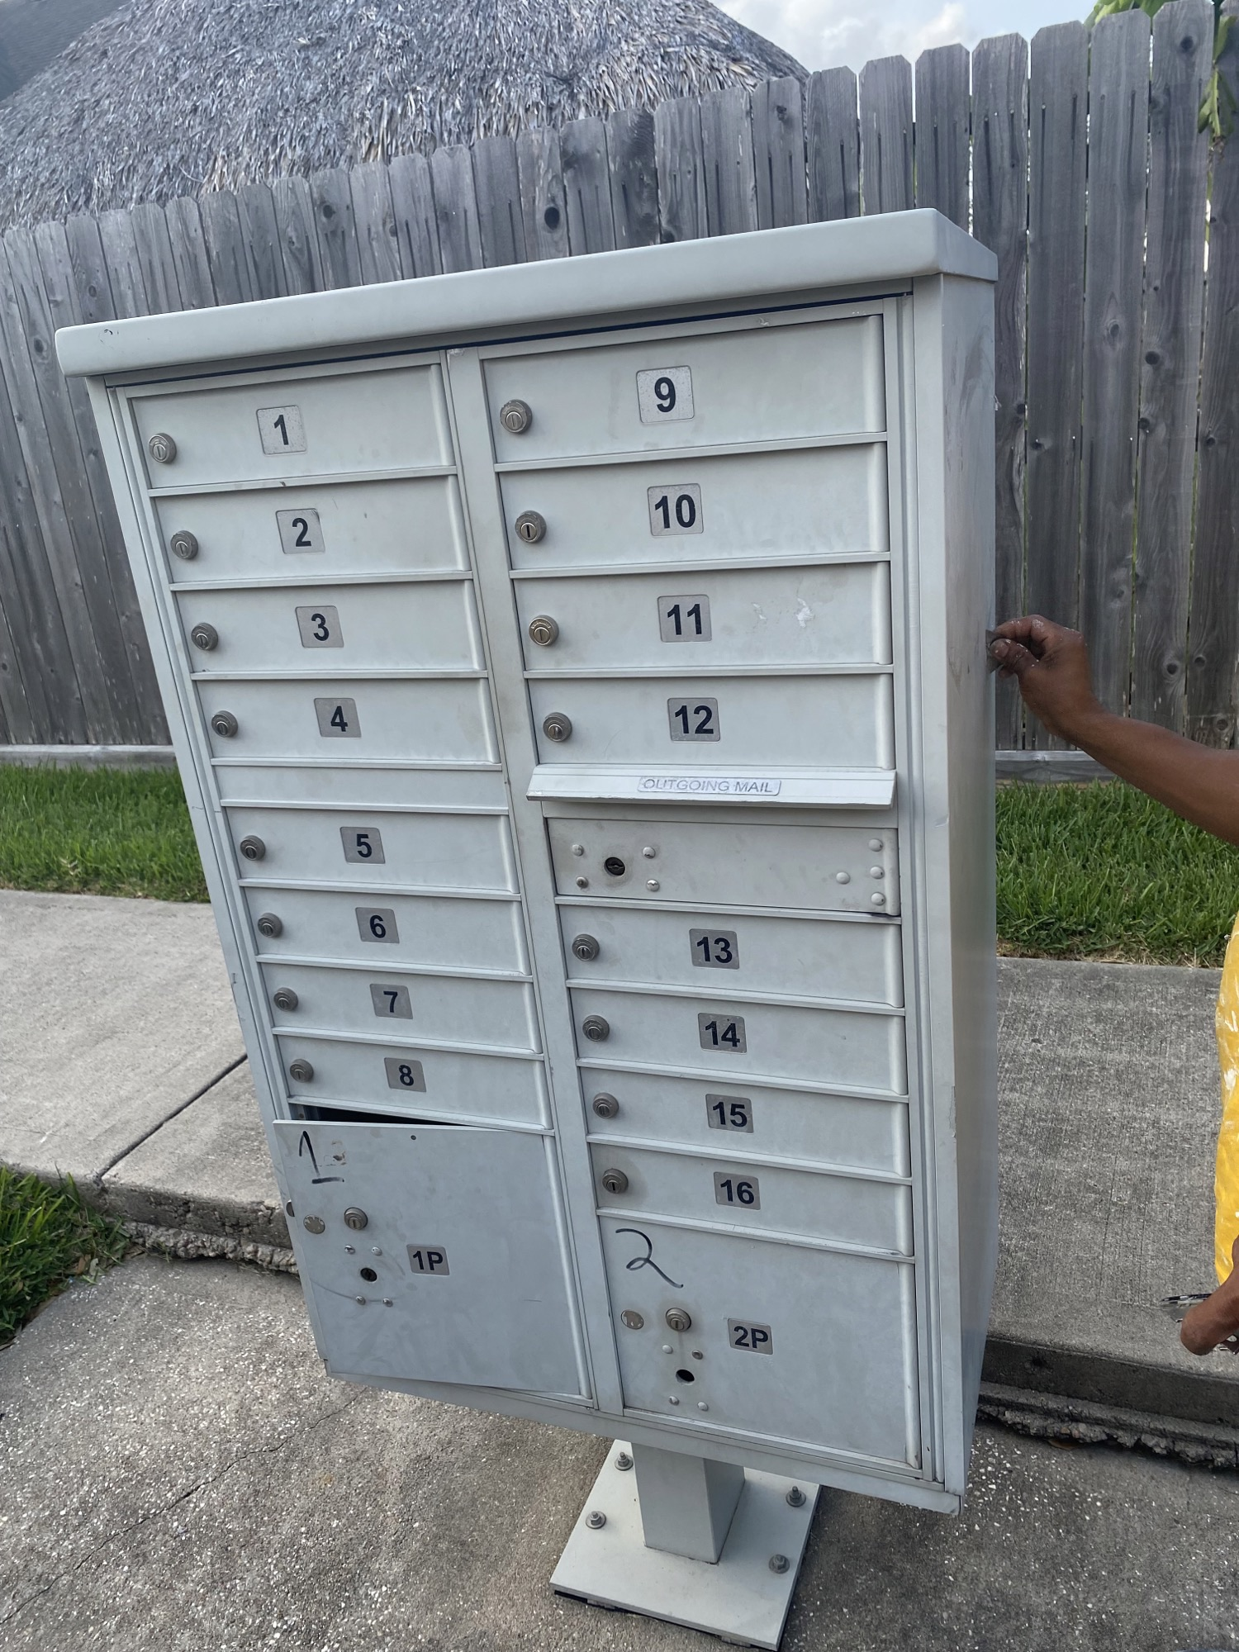
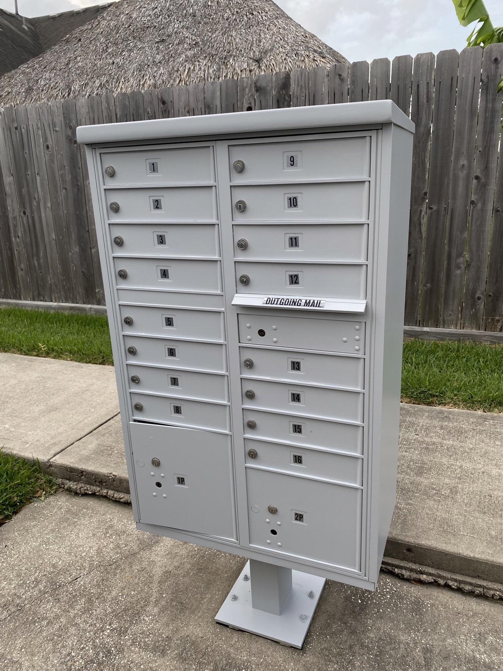
Mailbox Repaint

Slide 22
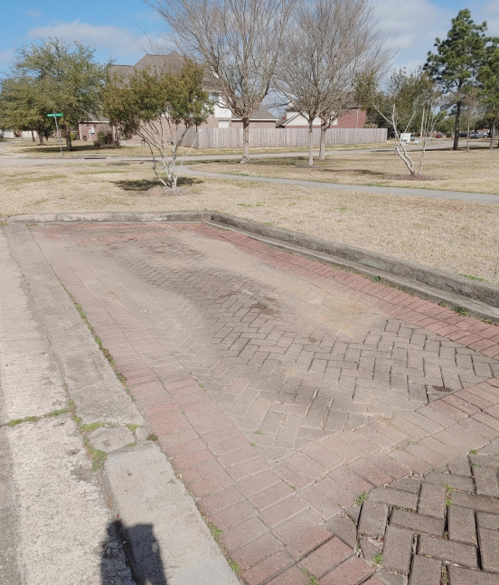
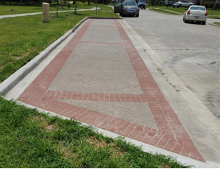
Pavers Replaced

Slide 23
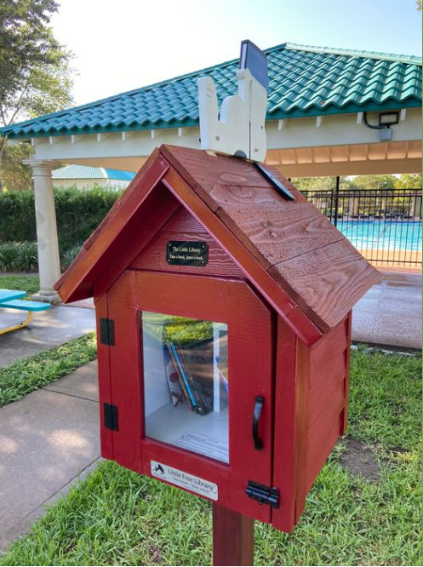
Free Little Library
Courtesy of Emma Downs – Brittany Lakes Resident

Slide 24
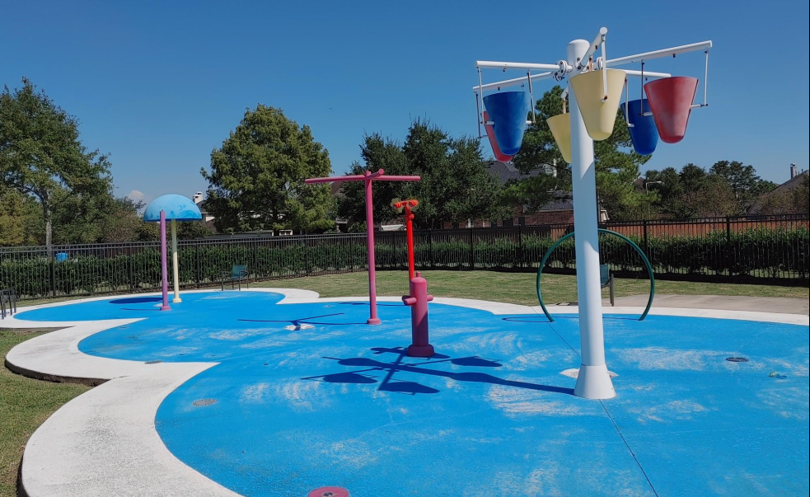
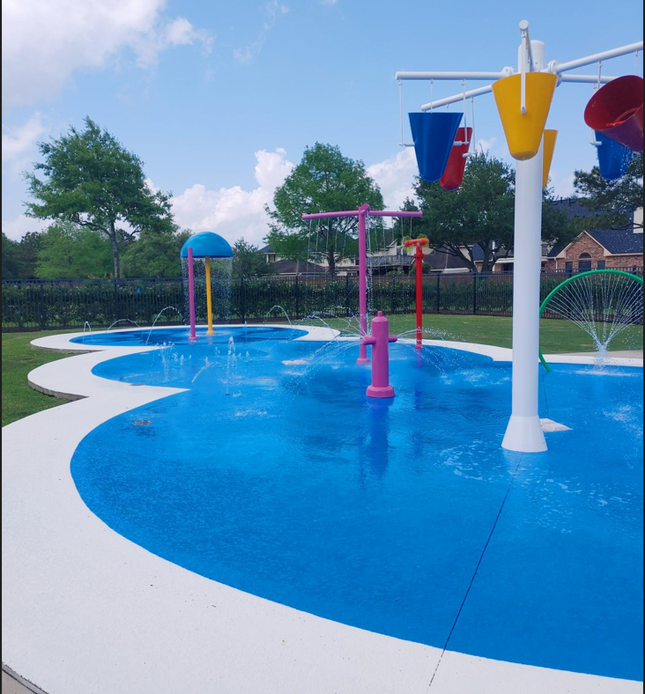
Splash Pad Repainted

Slide 25
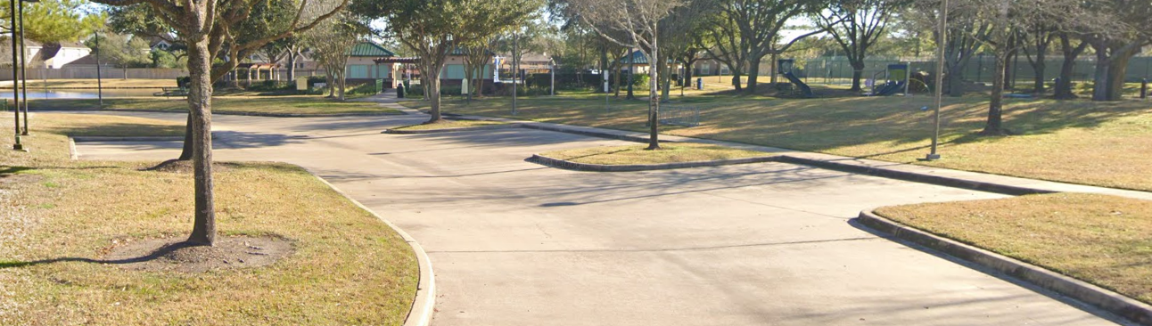
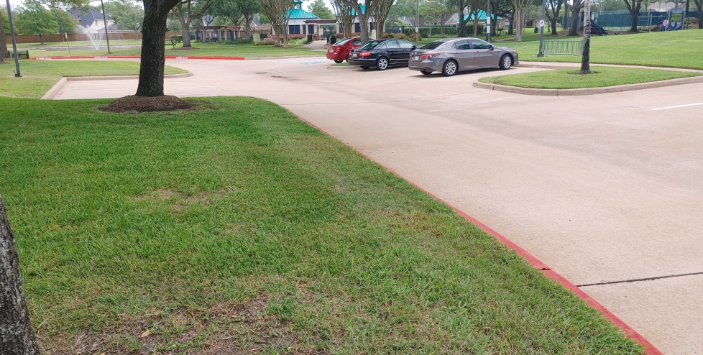
Parking Lot

Slide 26
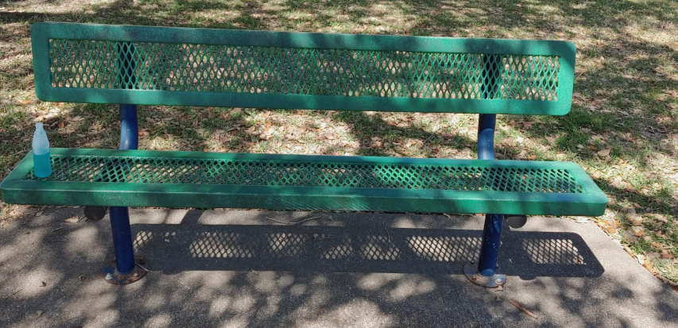
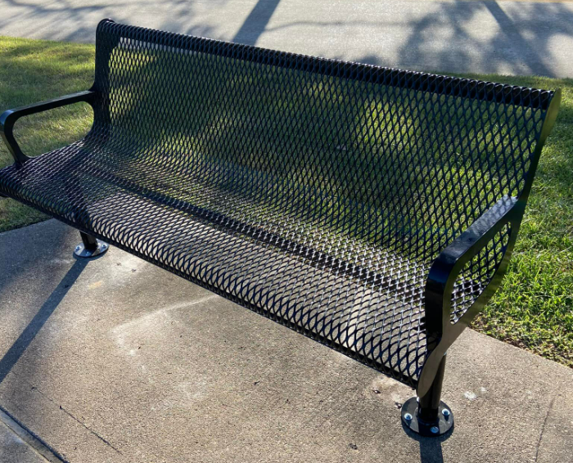
Bench Replacement

Slide 27
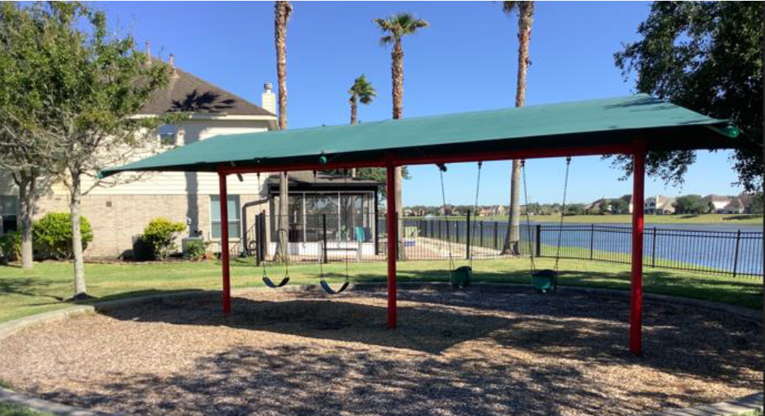
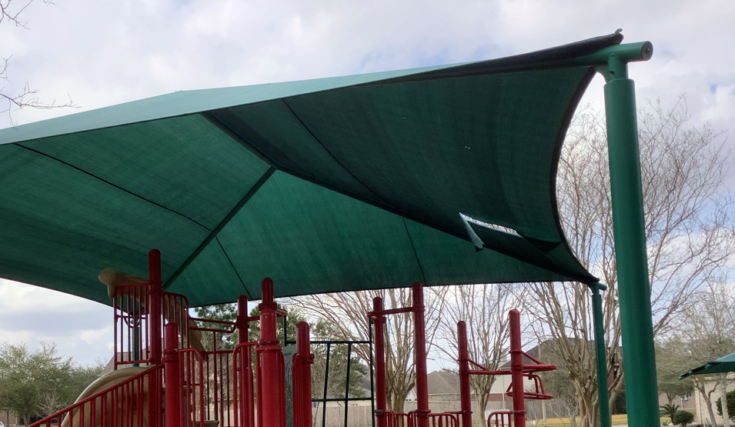
Canopy Replacement

Slide 28
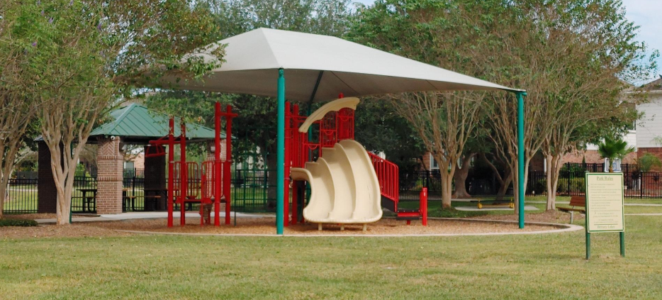
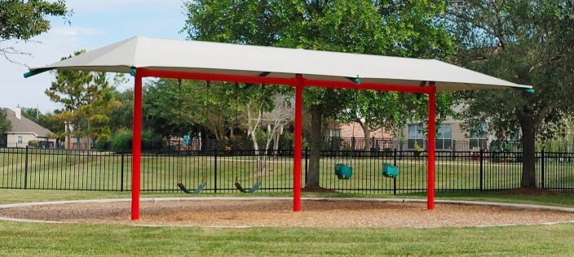
Canopy Replacement

Slide 29
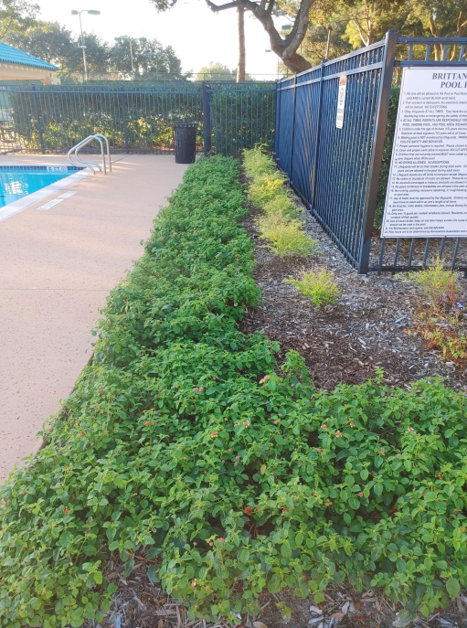
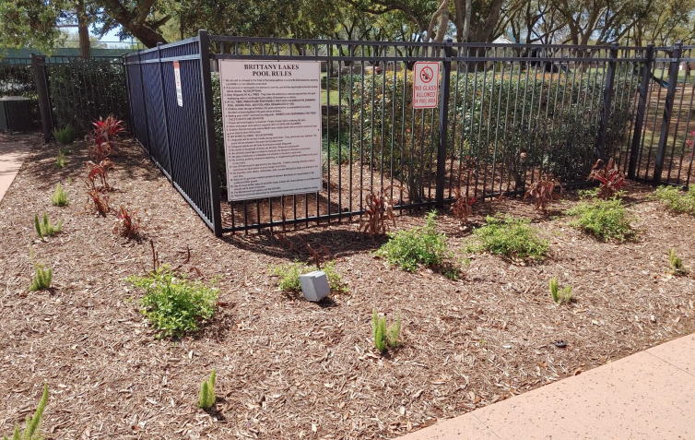
Landscaping Replacements – Pool Area

Slide 30
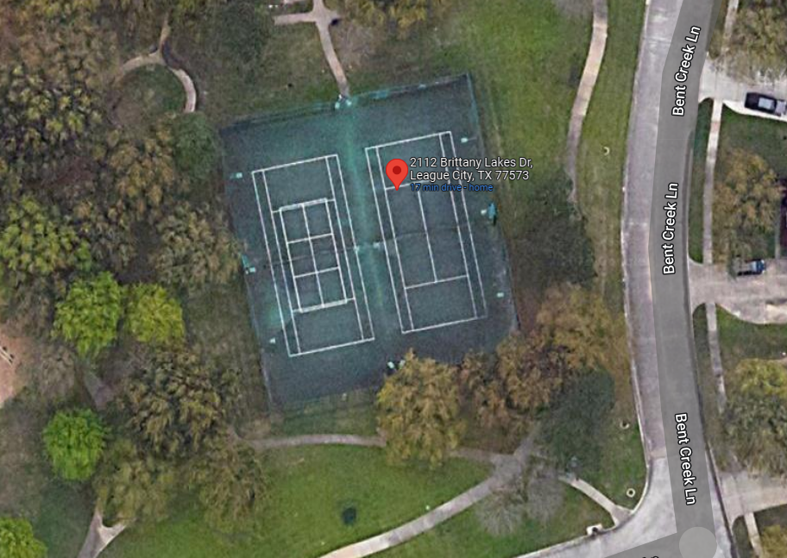
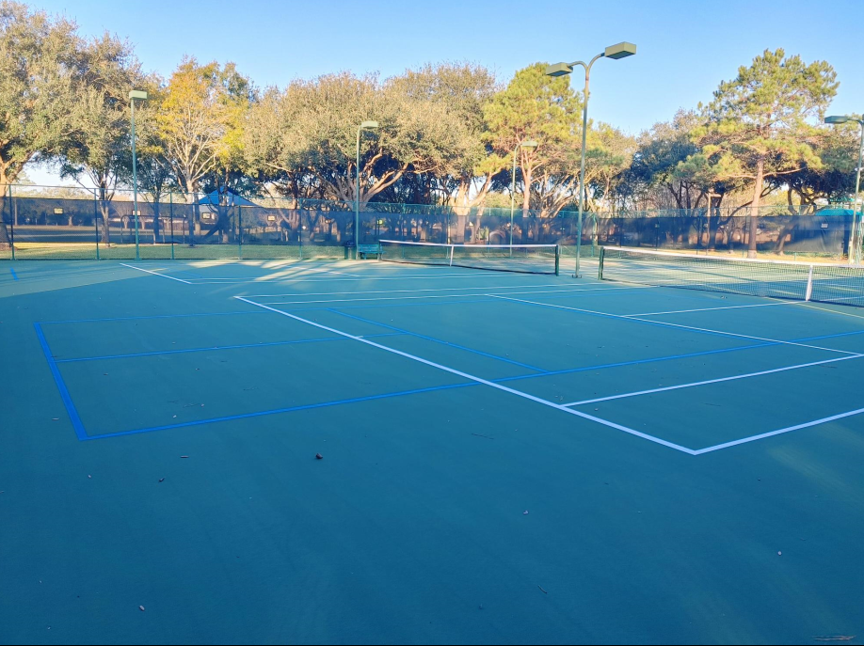
Tennis Court Resurface

Slide 31
Upcoming Community Projects
Repairs to the transfer pump that connects to the irrigation system
Continued emphasis on landscaping enhancements throughout the community (tree trimming, planting new trees, landscaping bed change-outs)
Fence repairs throughout the community
Sidewalk repairs throughout the Rec Center
Additional parking at the Rec Center
New Deck-o-Seal on pool deck
Shade structure refurbishment in the pool

Slide 32
Upcoming Community Projects
Mister replacement at the Rec Center
Pool light replacement
Kiddie mulch dig out and replacement

Slide 33
Board of Directors Candidates
Mark Buehler
Jim Pearson
Kimberly Widener

Slide 34

Board Election Results
Congratulations and welcome to the Board of Directors & Committee Members:
Notes:
Will update by COB July 28th with election results

Slide 35
Questions & Answers
?????

Slide 36


